Slide 1

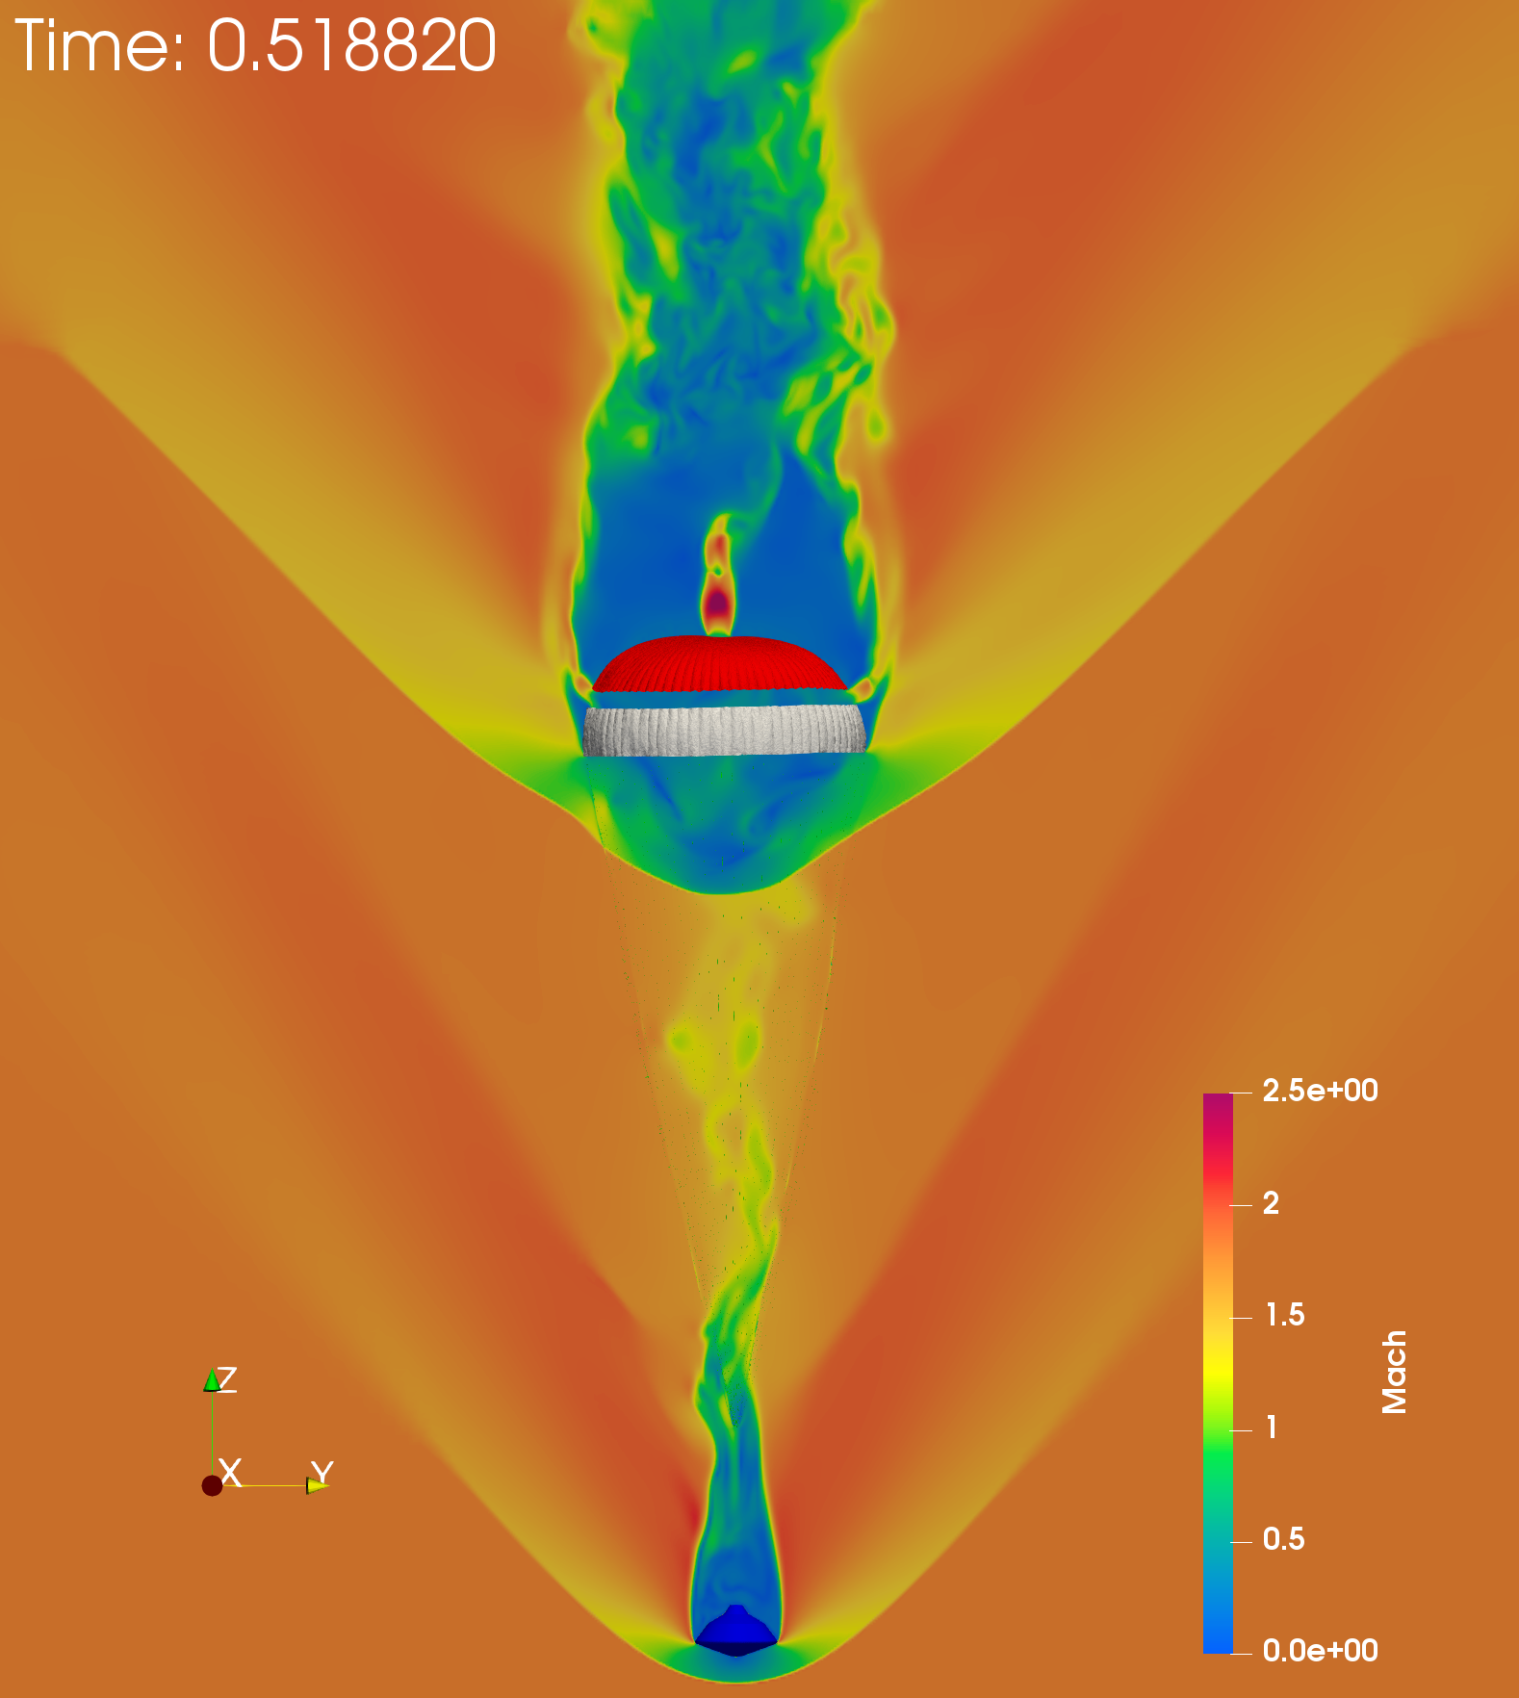
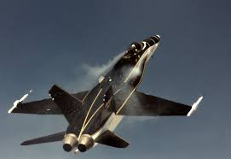
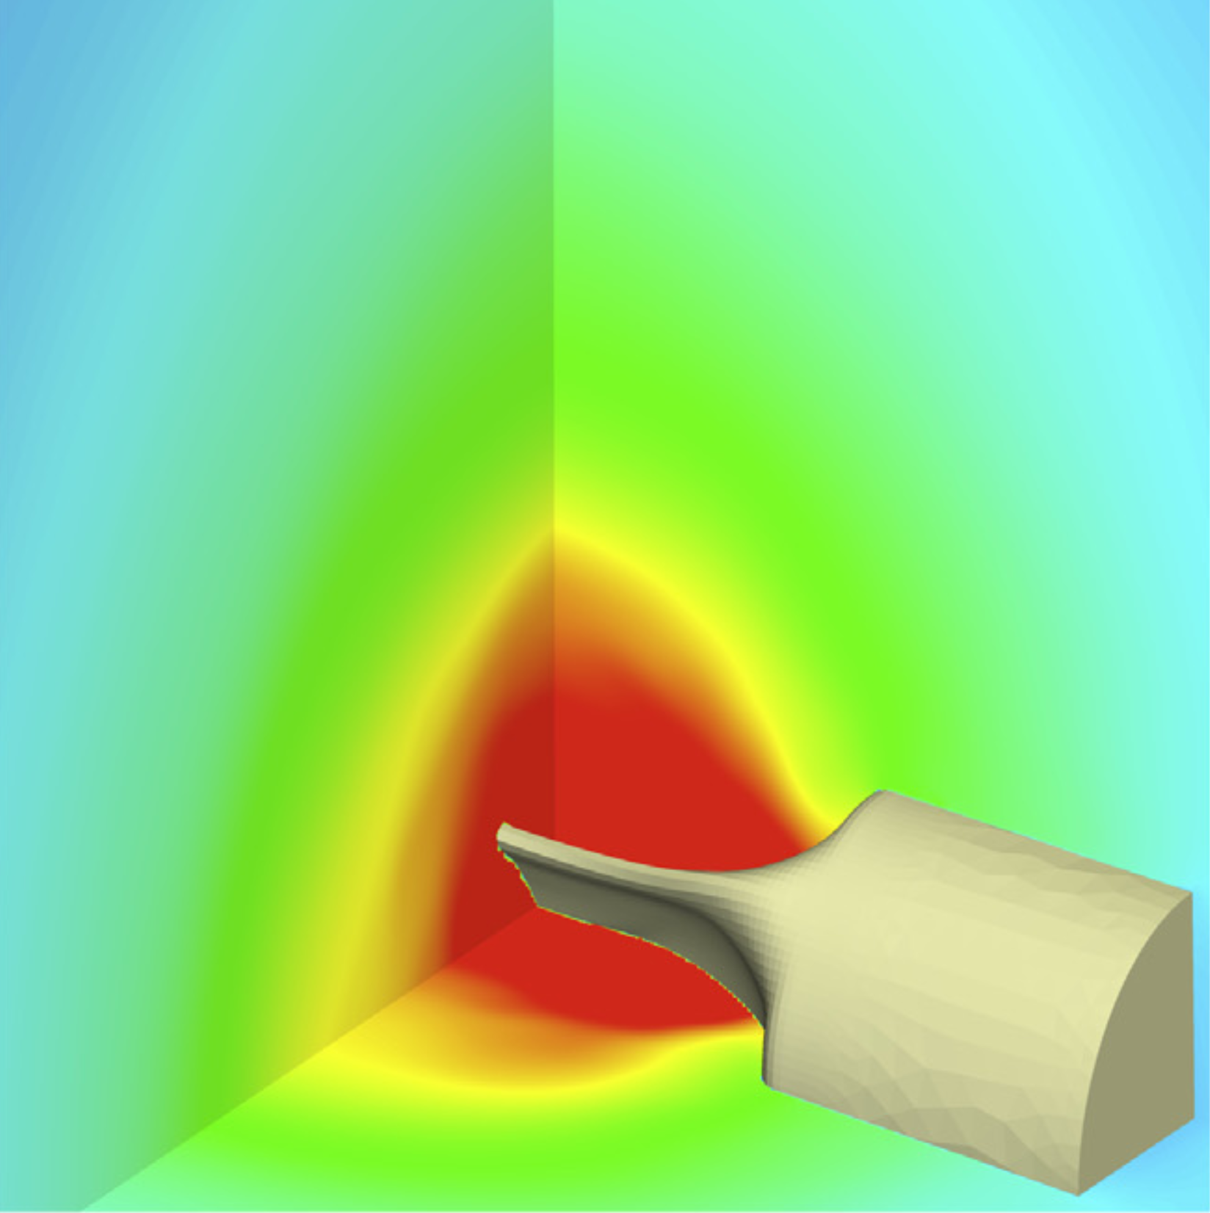
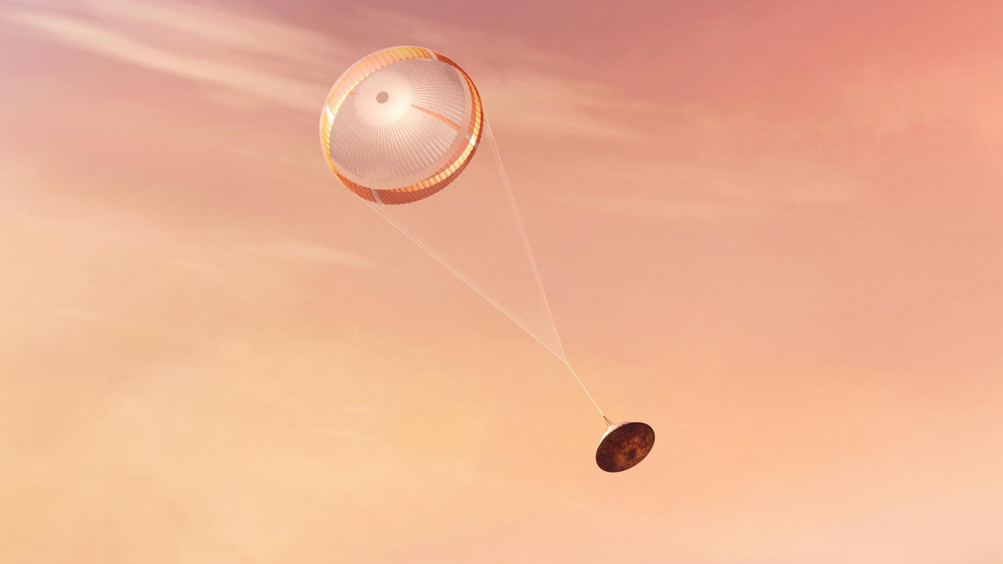
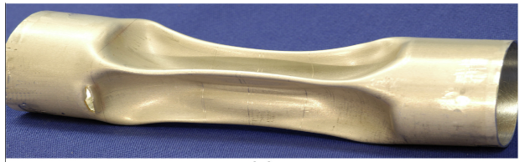
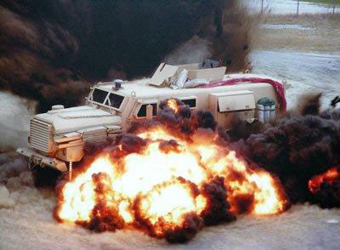
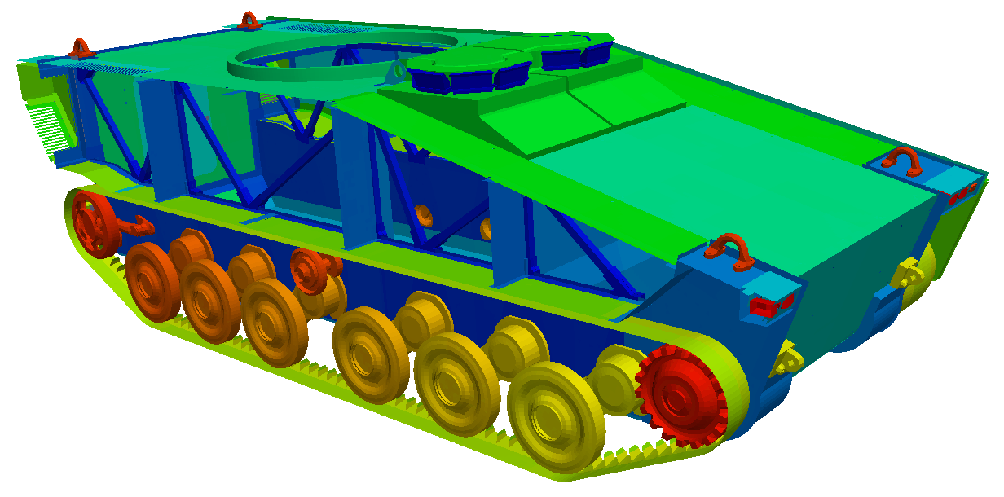
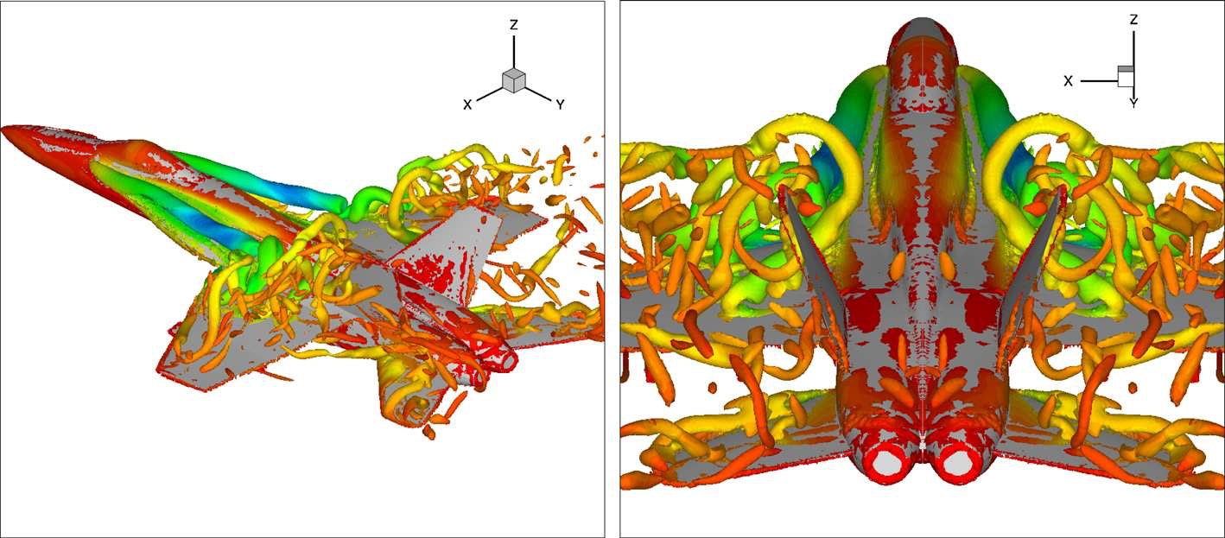
Open Source Computational Framework
AERO tutorial (under construction)
- to tackle complex engineering problems
- to test novel data-driven approaches on real-world
engineering problems
https://github.com/Zhengyu-Huang/AERO-Tutorial.git
Notes:
During my PDE, we developed numerical methods and open-source software to understand the parachute inflation dynamics, we have shocks, turbulence wakes, structure large deformation, and porisoties…… And in NASA JPL’s finally test, our predicted drag performace (the blue curve) matches well with the only data we have, that collected during curiosity rover (black curve)
I will say the differences are due to the uncertainties about parachute material, Mars atmosphere condition…. That leads to my second direction

Slide 2
AERO Simulation
simulations
data
sources
preprocess.sh
case1
fluid.geo fluid.top
structure.geo structure.top
postpro
references
FluidFile
StructureFile
run.sh
Sbatch.sh
results

Slide 3
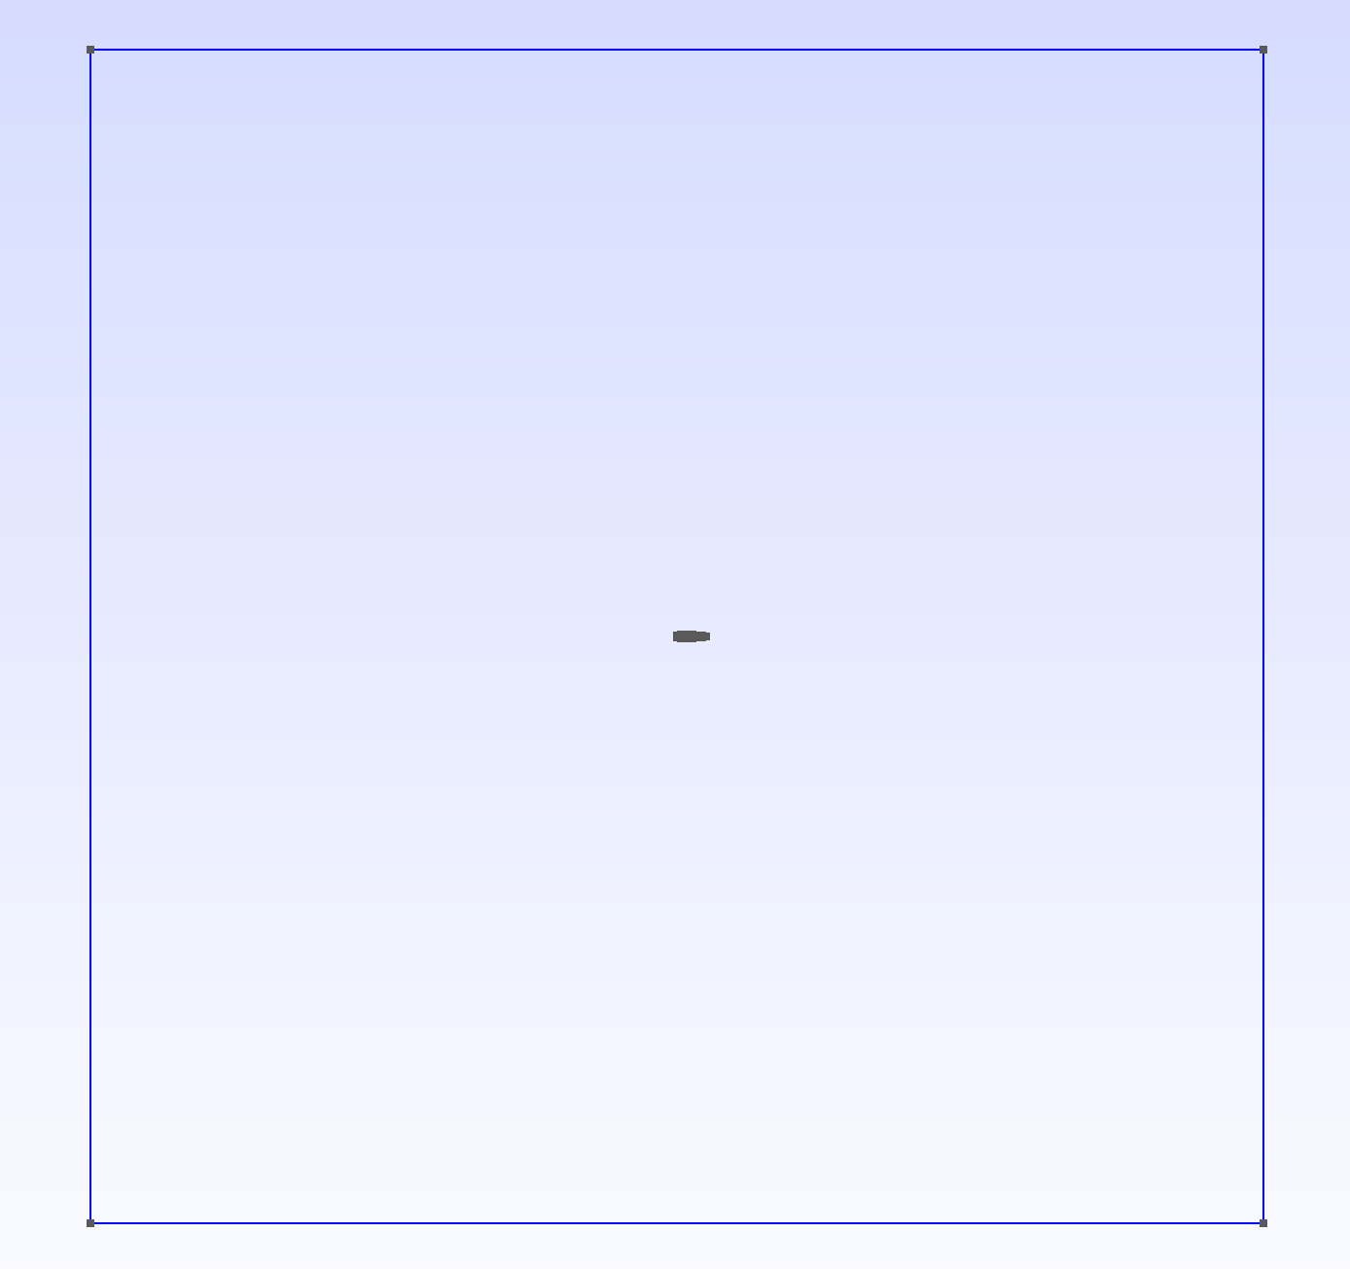
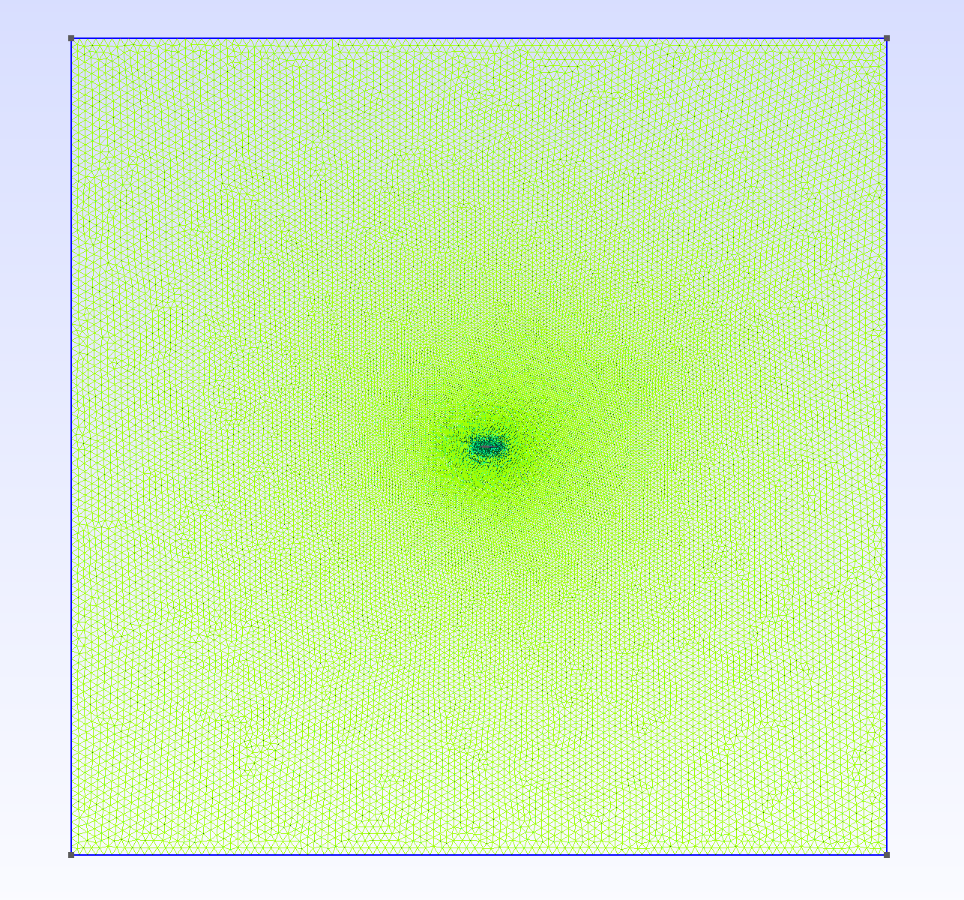
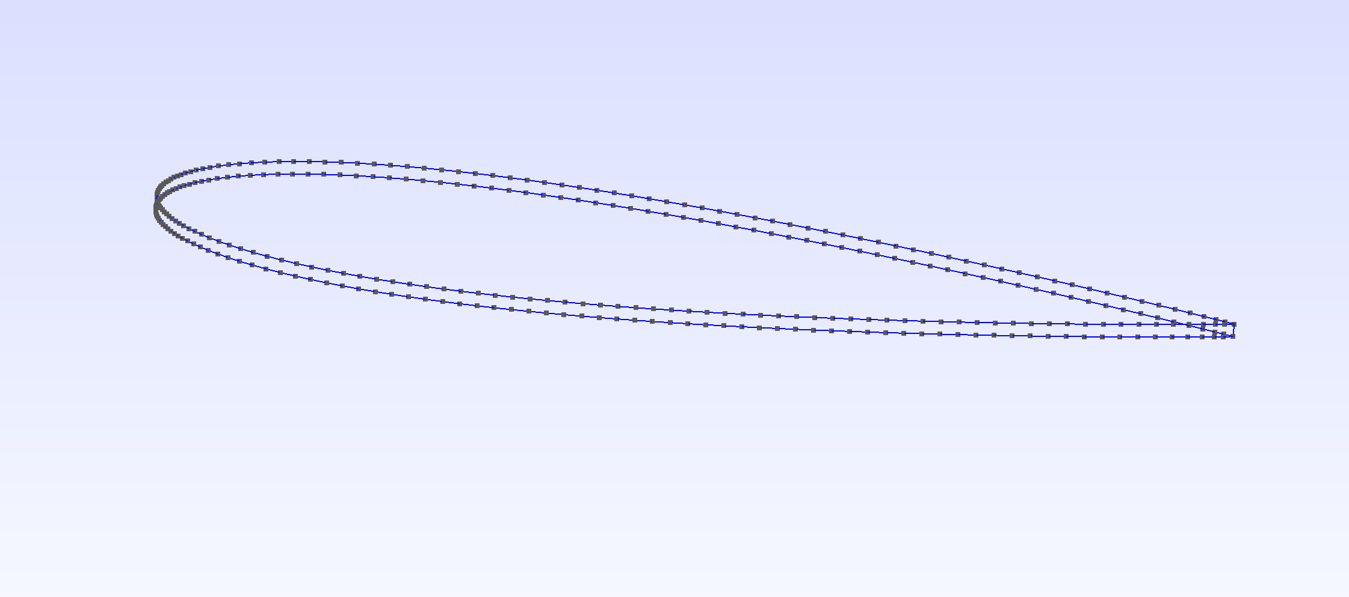
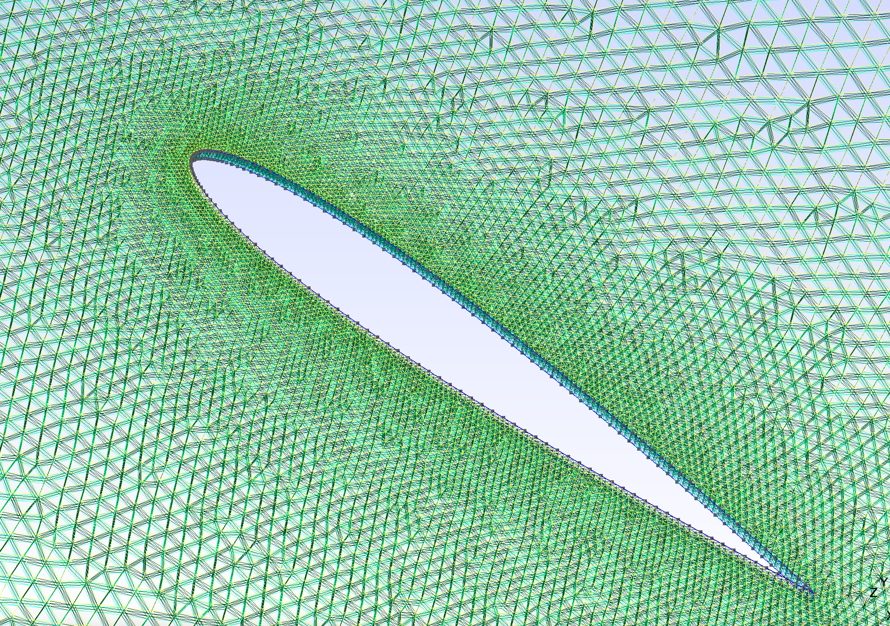

Slide 4
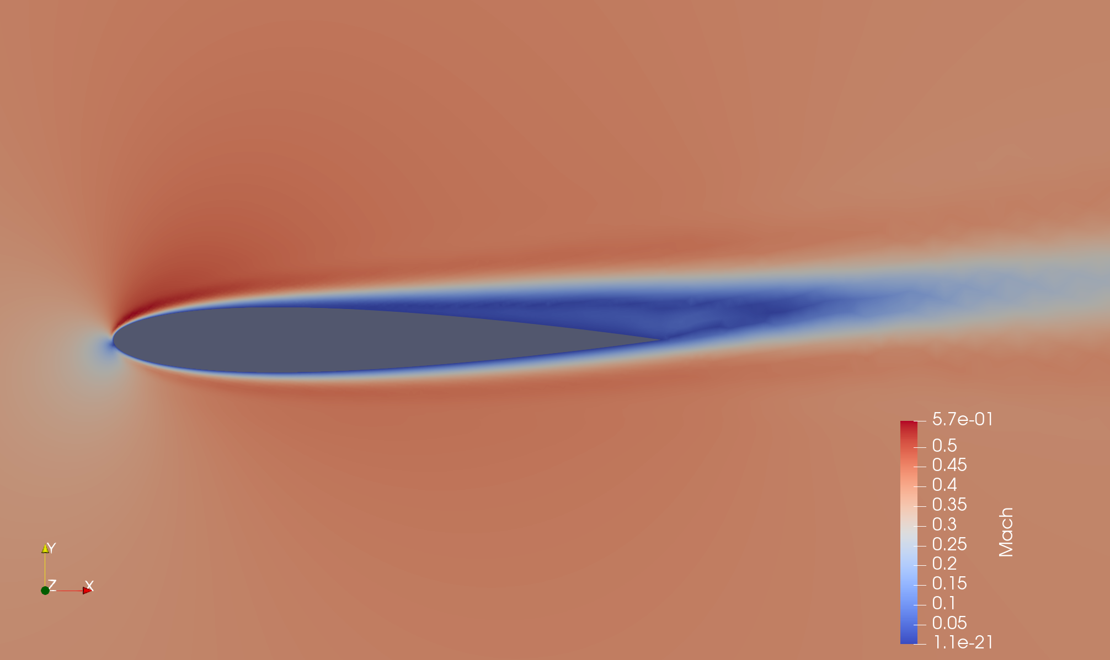
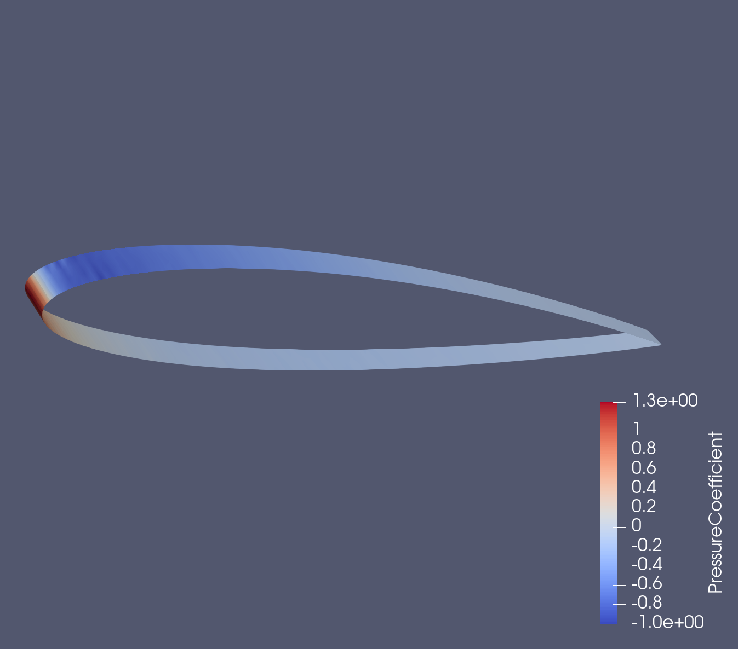

Slide 5
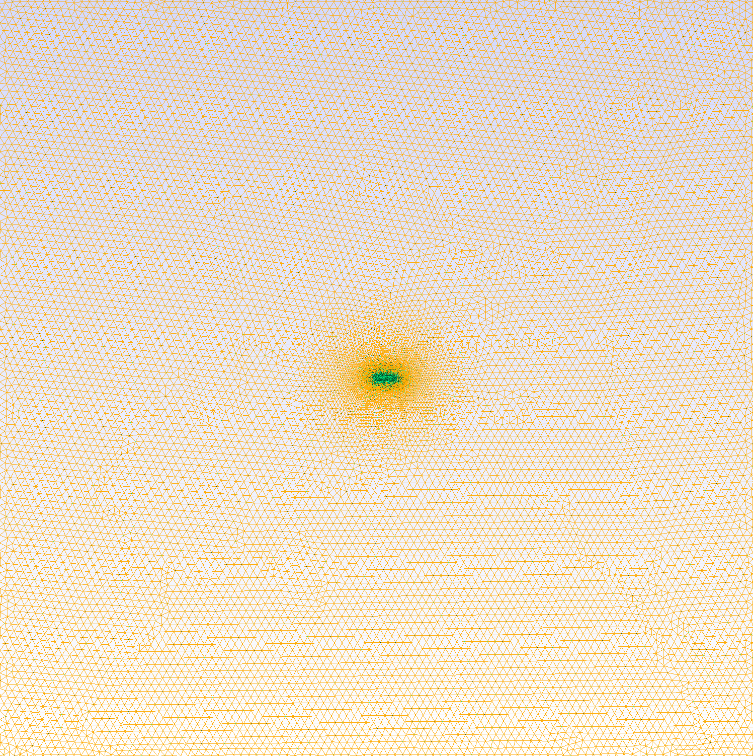
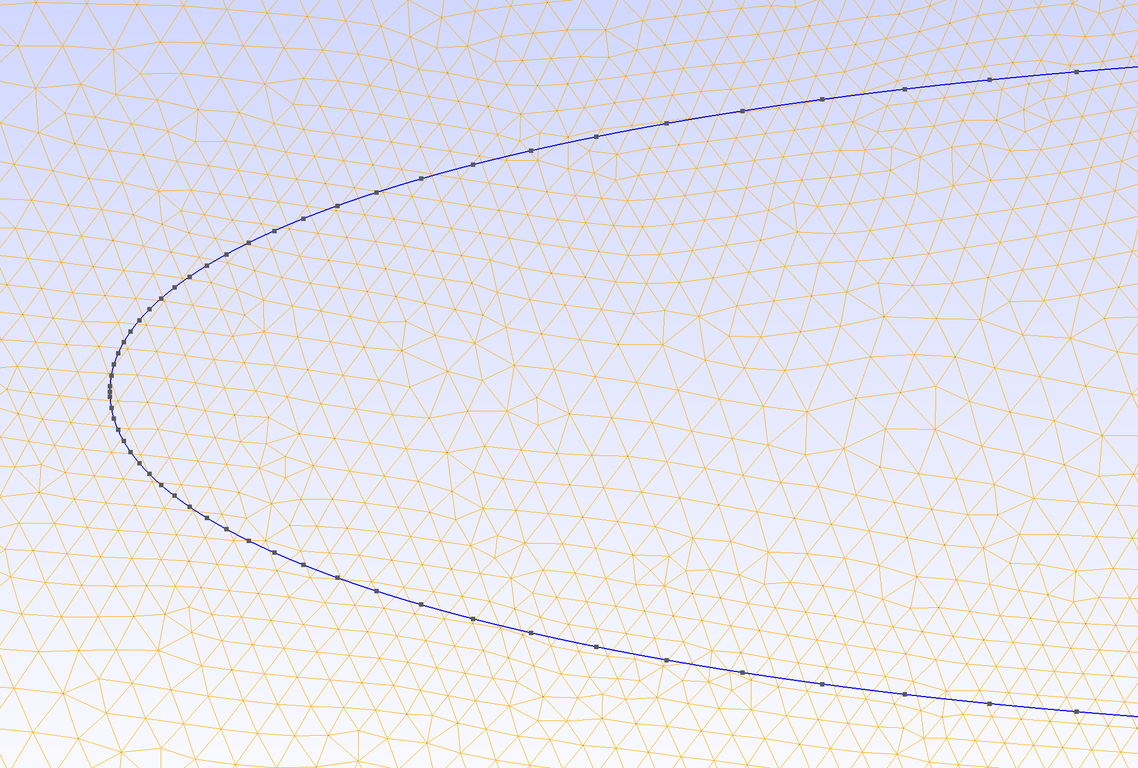
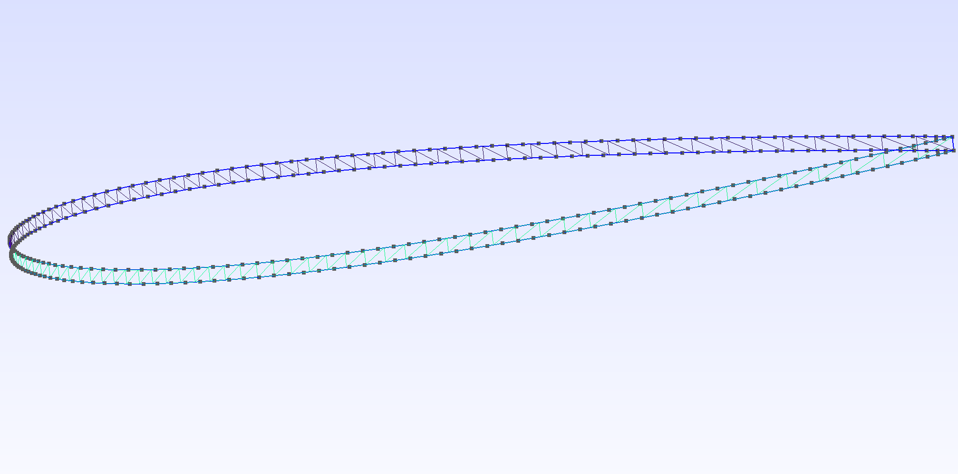

Slide 6
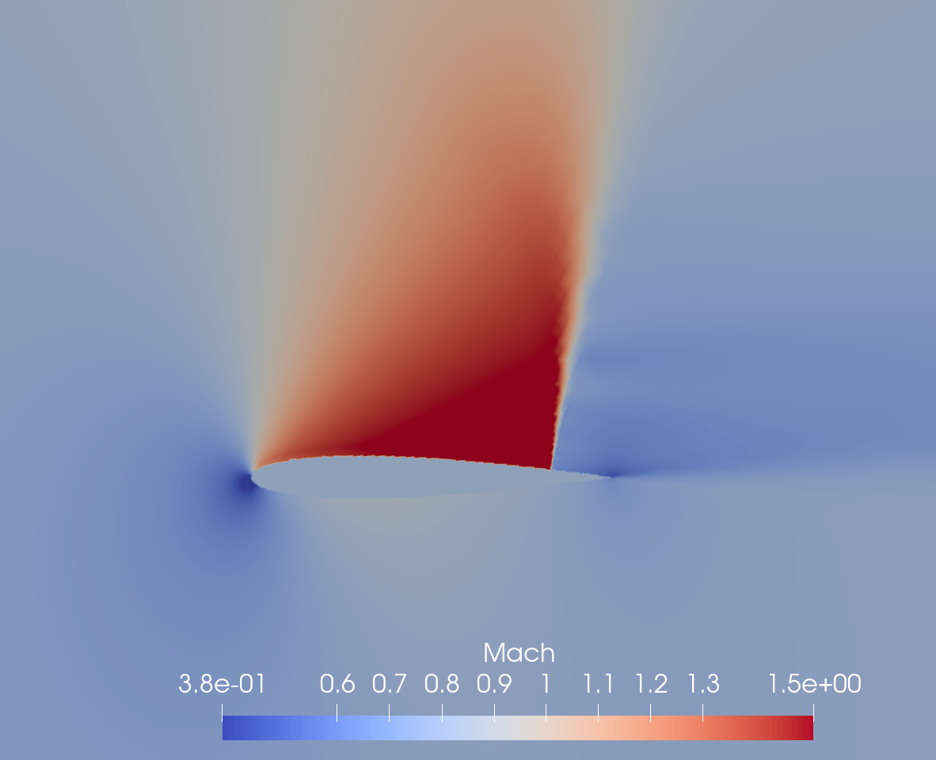
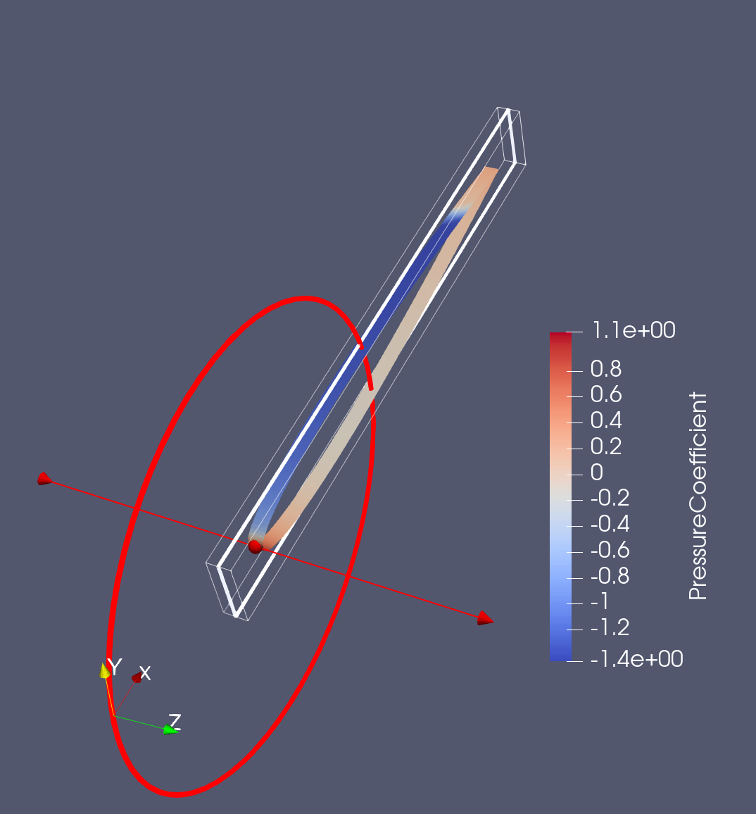
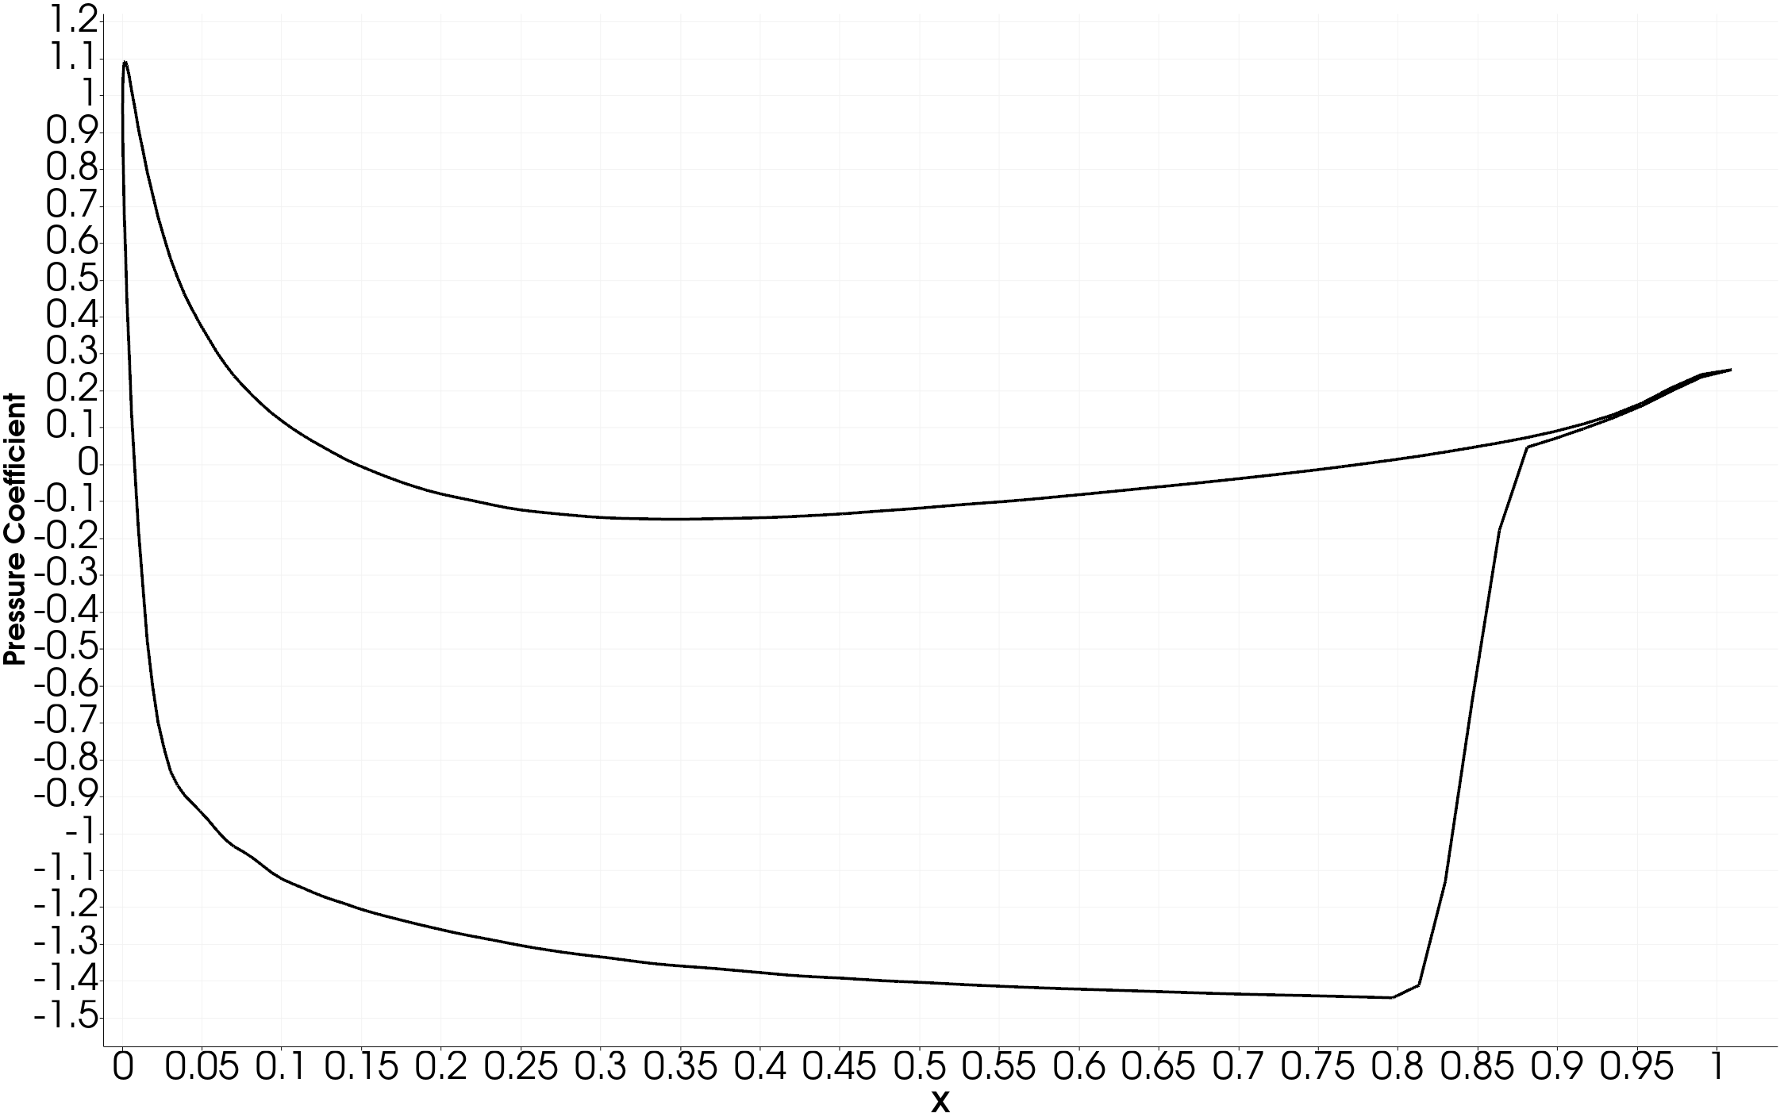

Slide 7
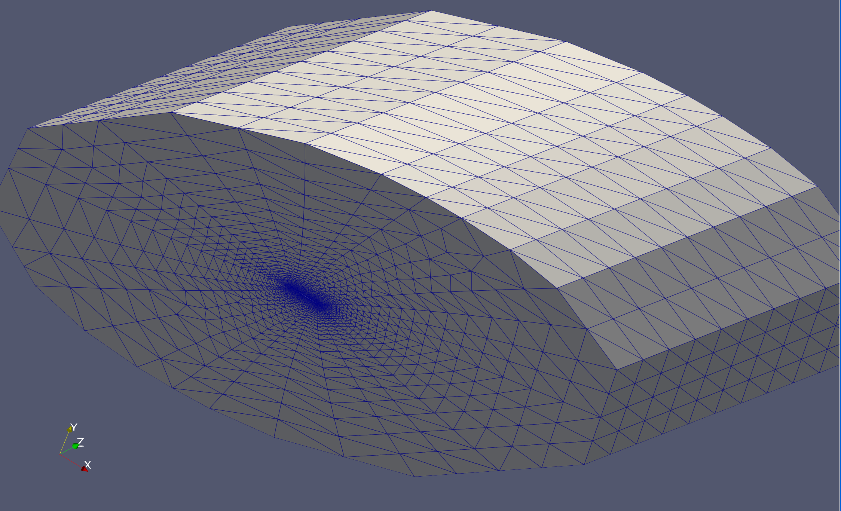
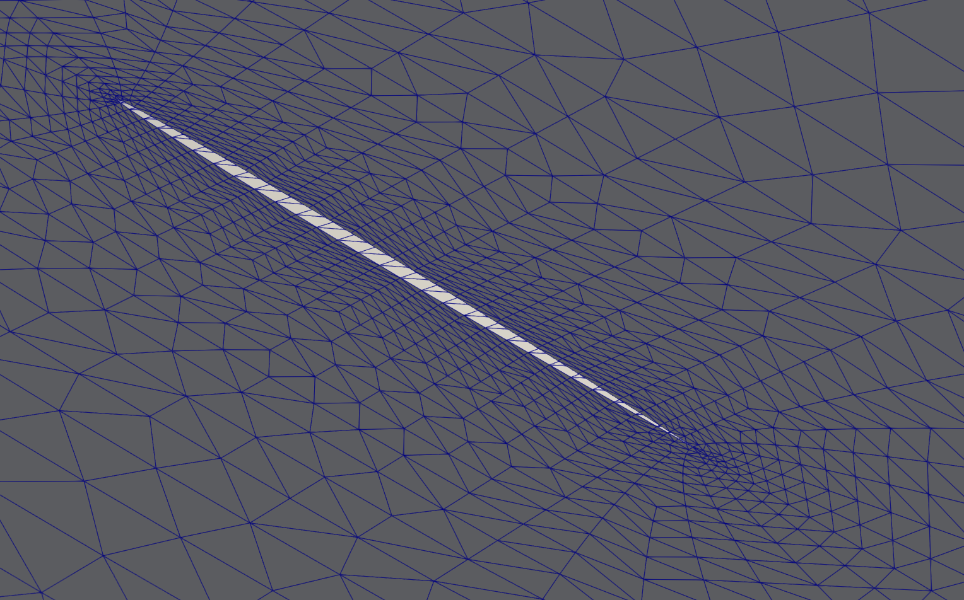
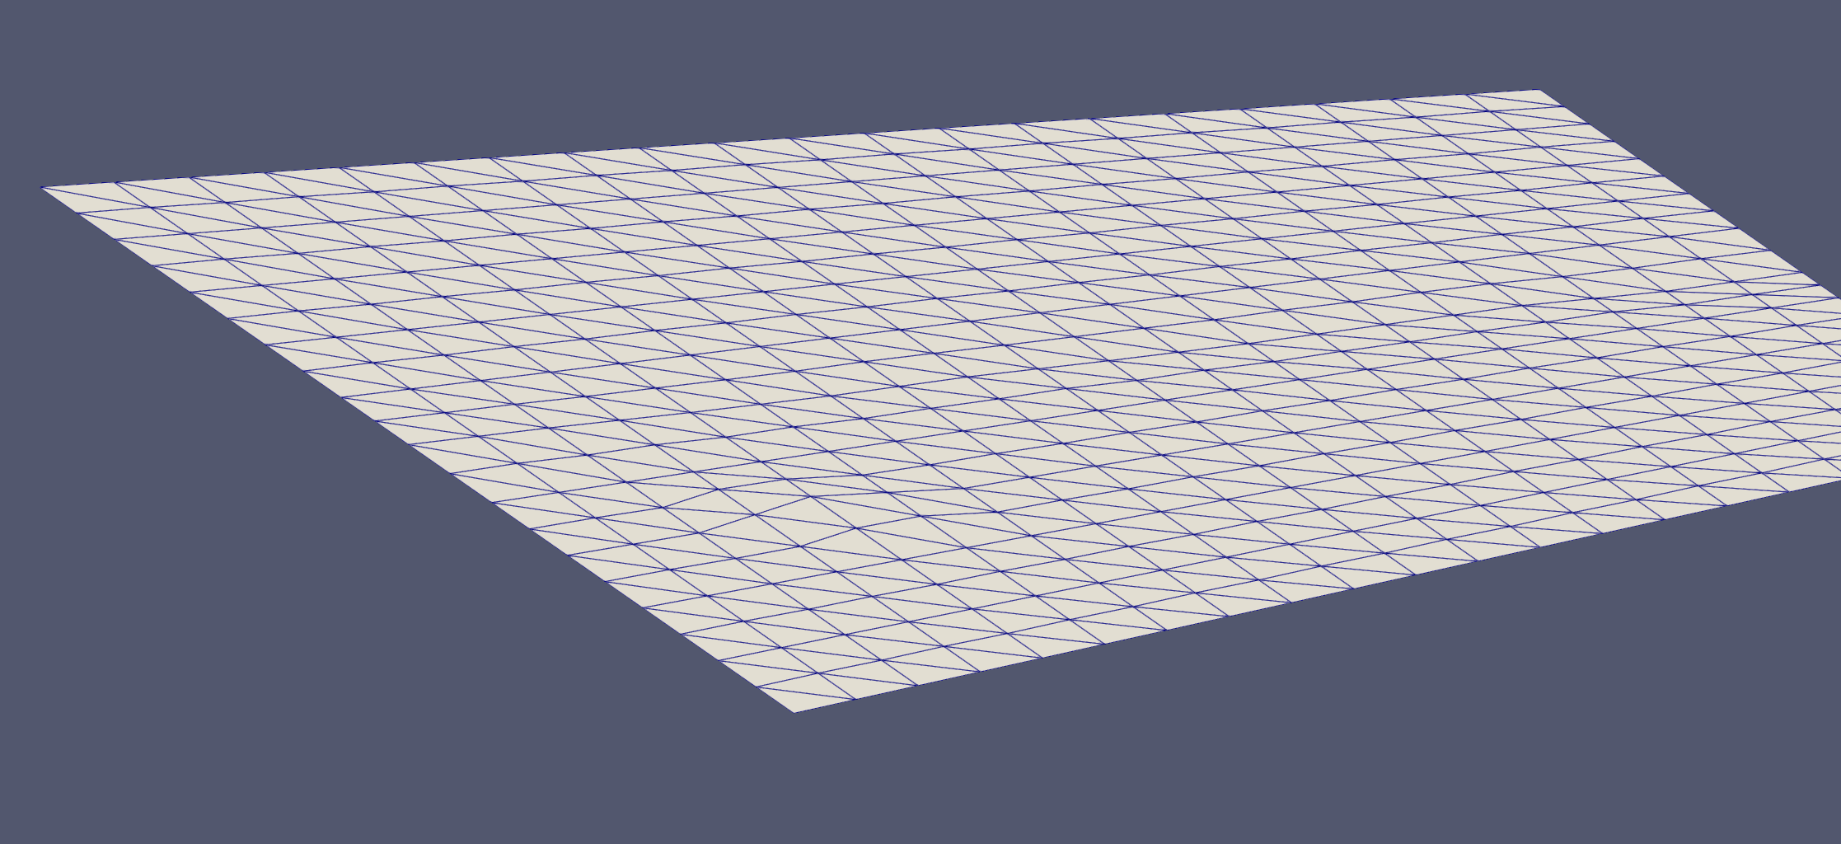
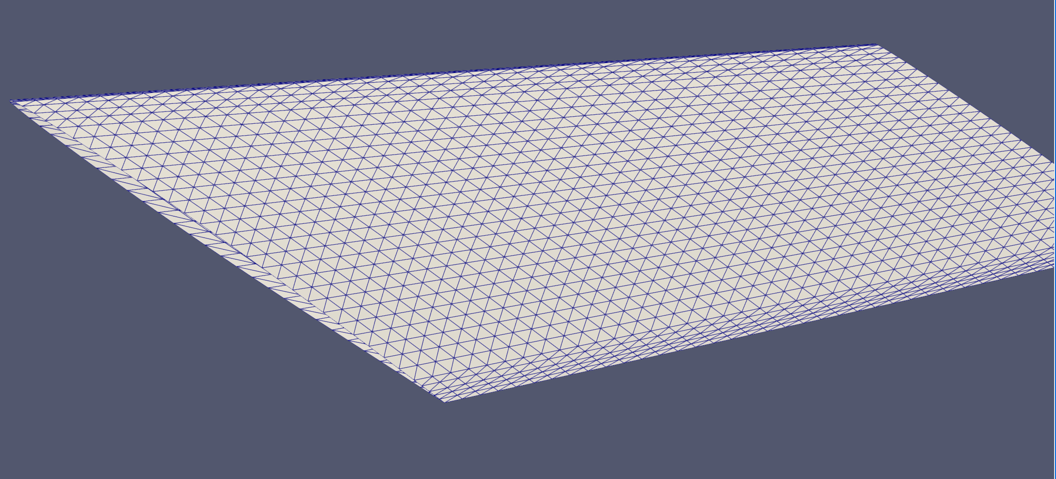
OutletFixedSurface
SymmetryFixedSurface
Shell Elements
StickMovingSurface

Slide 8
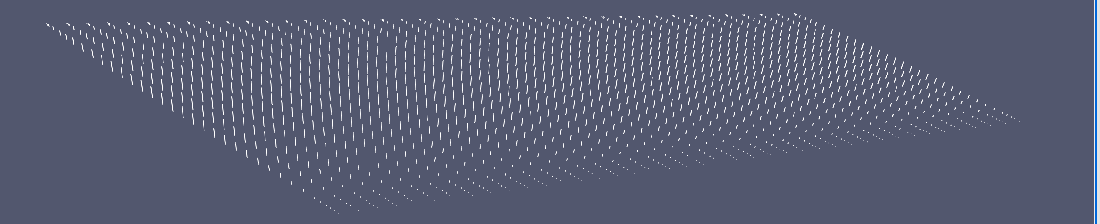
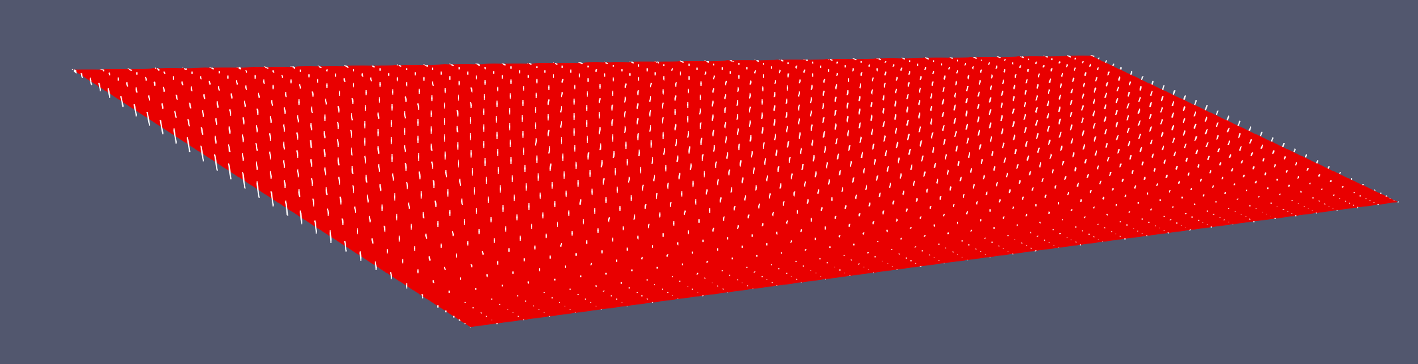

Slide 9
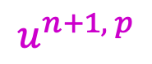
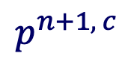
CFD Mesh$x^{n} { x}^{n+1}=x^{n}+{T^{n+1}Δu^{n+1, p}}^{ }$
­
Fluid $w^{n} w^{n+1}$
$$u^{n+1, p}$$
$$p^{n+1, c}$$
Structure $u^{n} u^{n+1}$

Slide 10
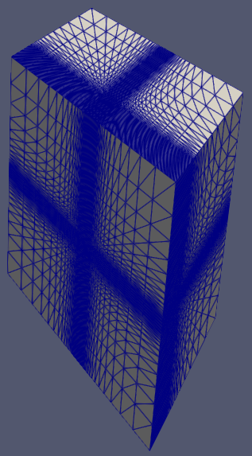
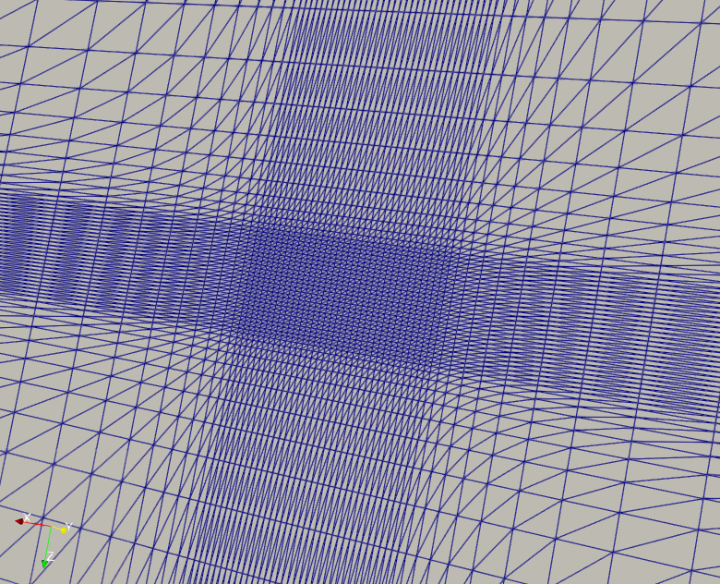
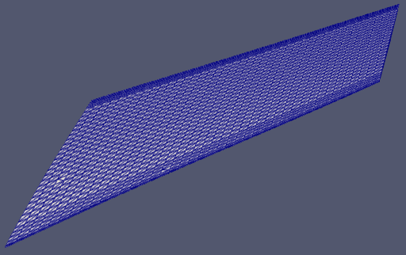
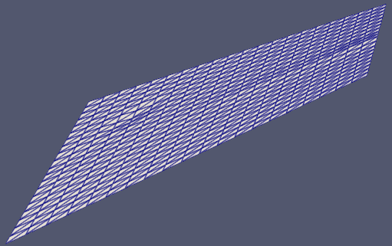
浸入表面
流体网格
固体网格

Slide 11
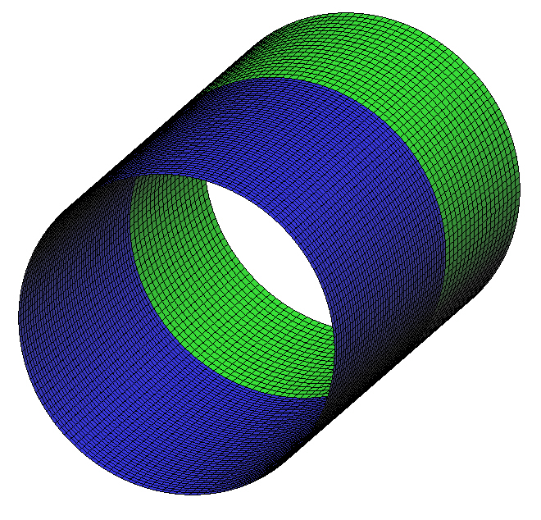
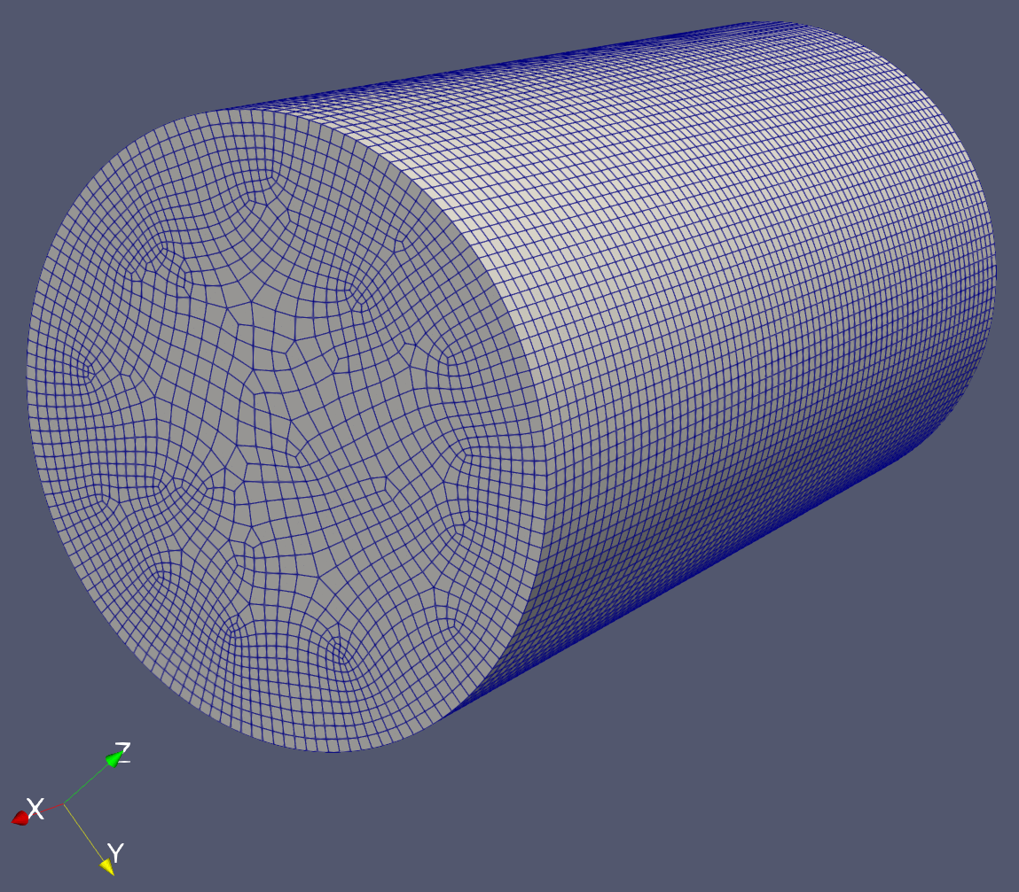
空心圆柱体模拟
滑移边界条件
x
y
2.5007 in
尺寸：2.5007in（长） x 1.4727in（直径）
(对圆柱体的中间表面进行建模)
模型：9,504 壳单元
平均有限元边长= 0.034in
对于缺陷服从4个峰谷的正弦大小为0.083%的位移，计算的临界屈曲压力为670psi；实验值是 676psi。
z
0.73635 in
对称边界条件（一圈）

Slide 12
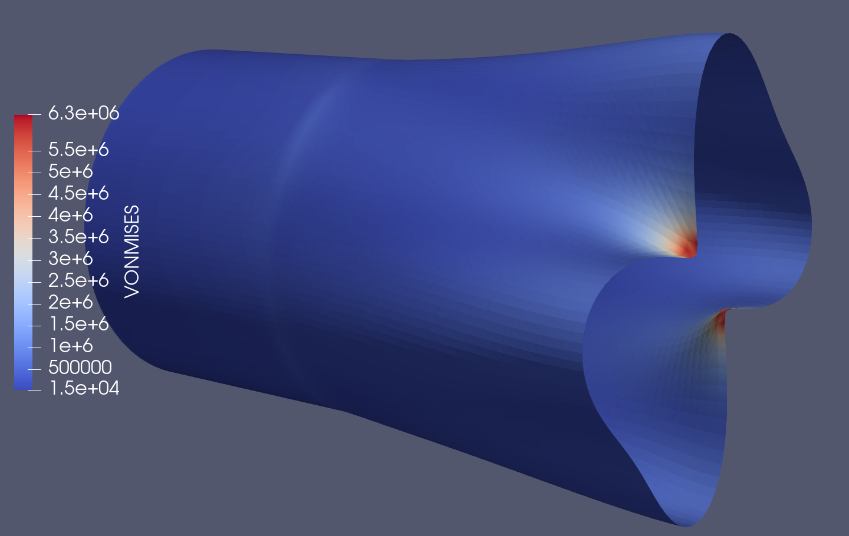
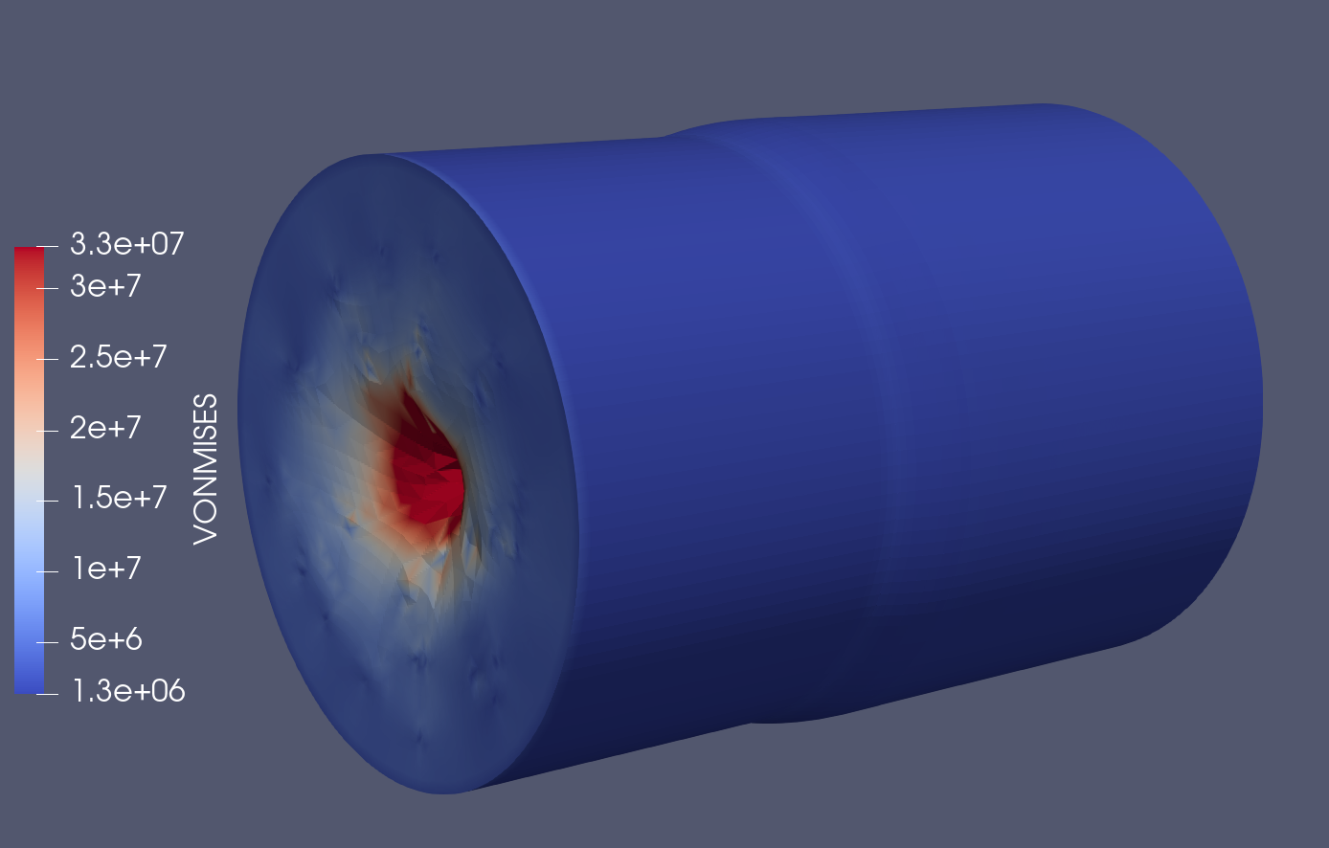

Slide 13
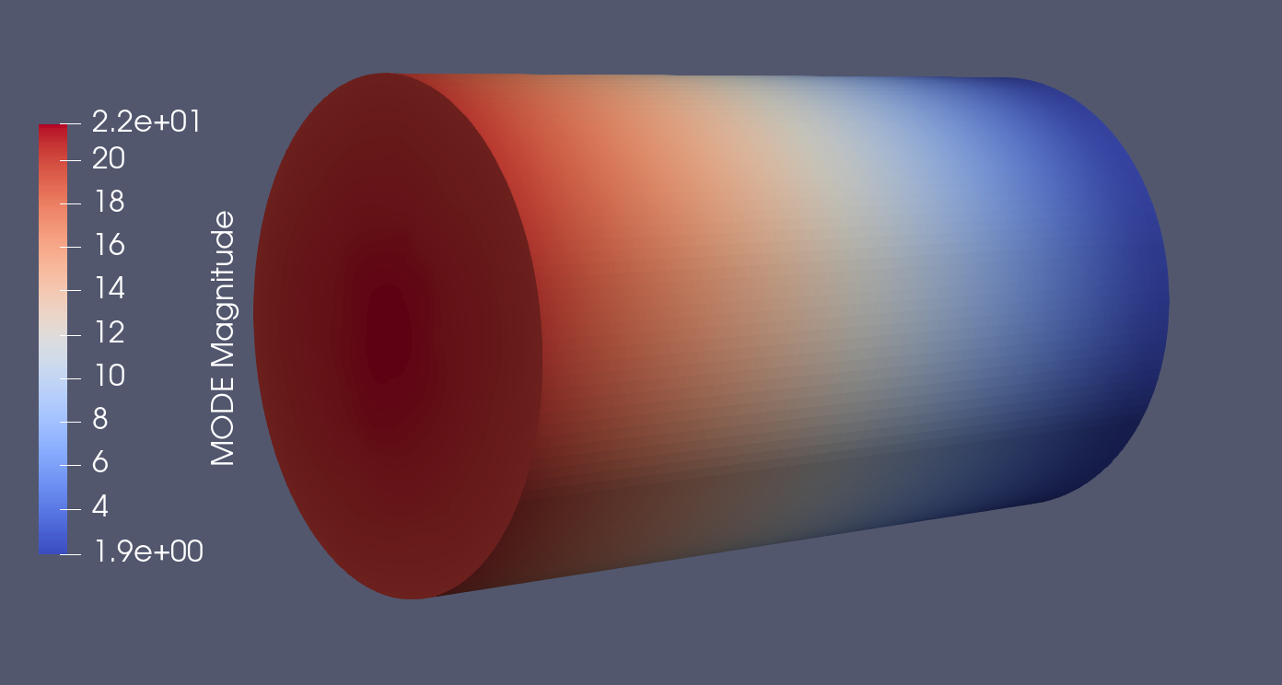
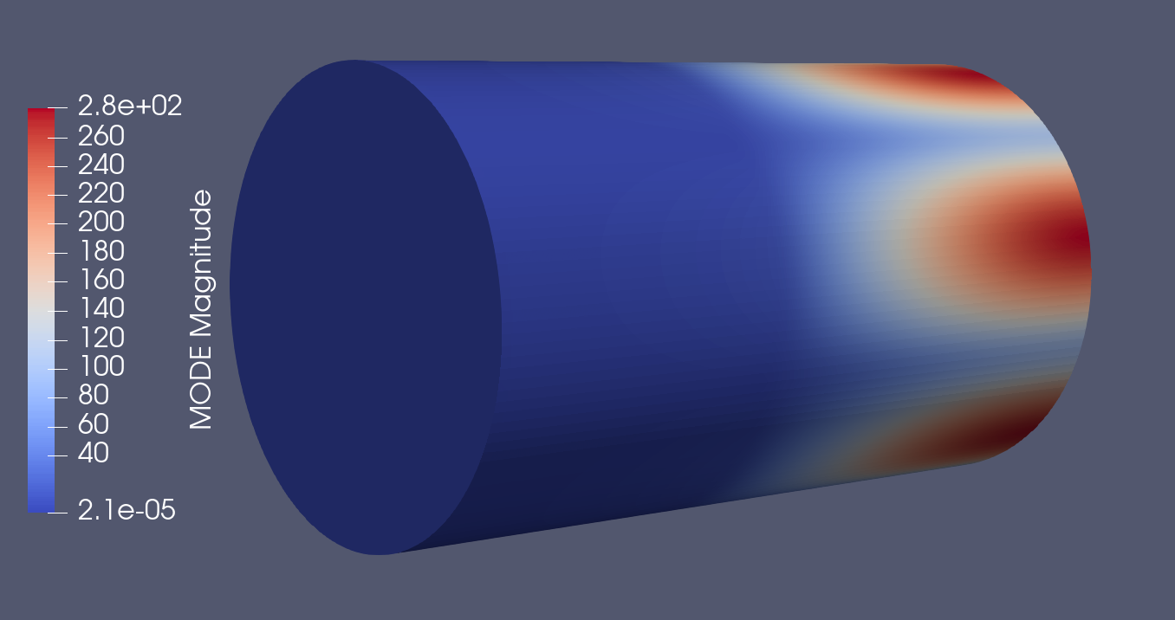

Slide 14
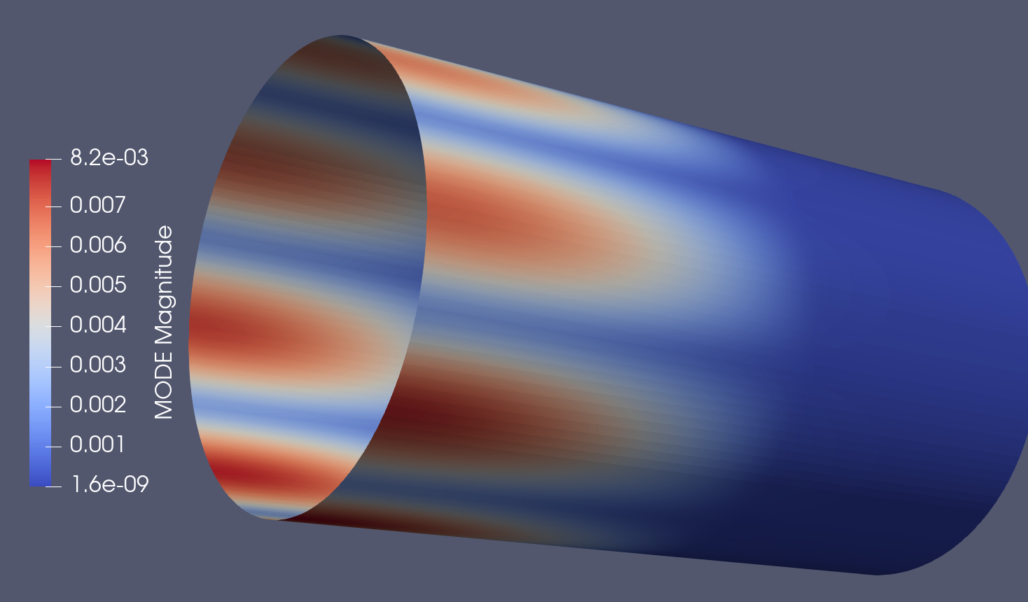
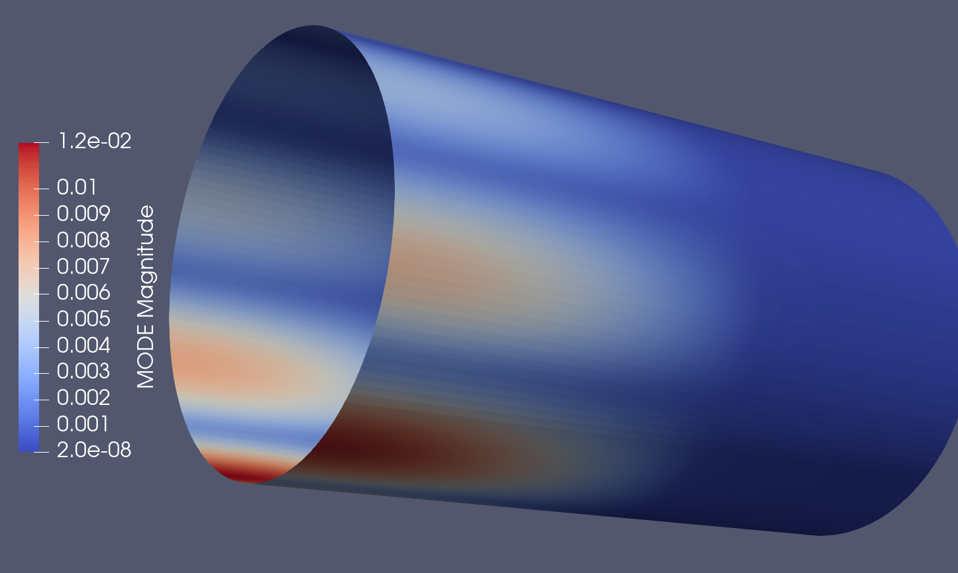

Slide 15
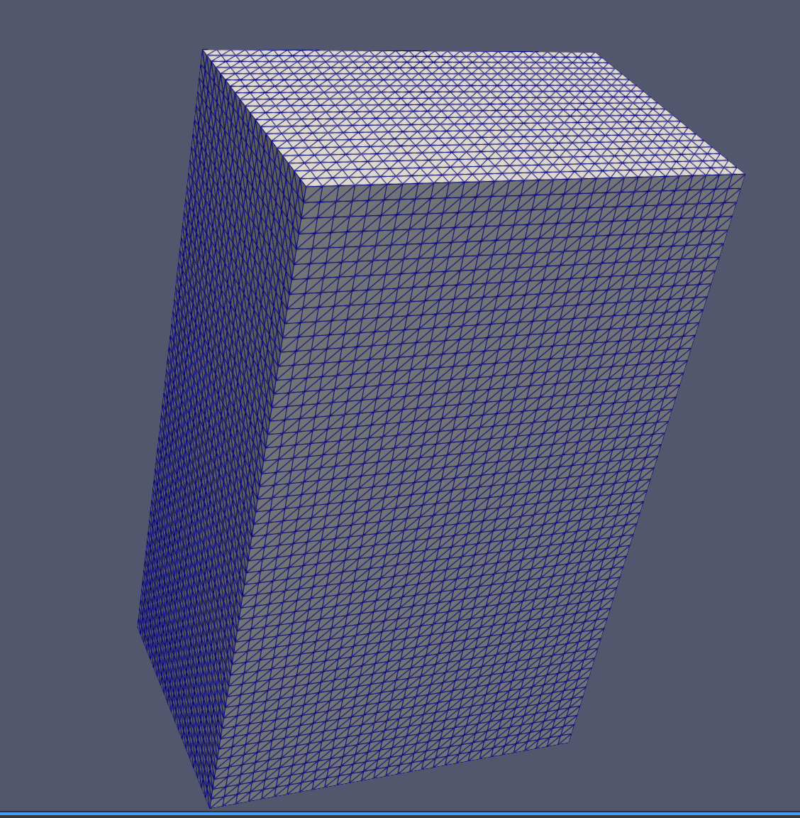
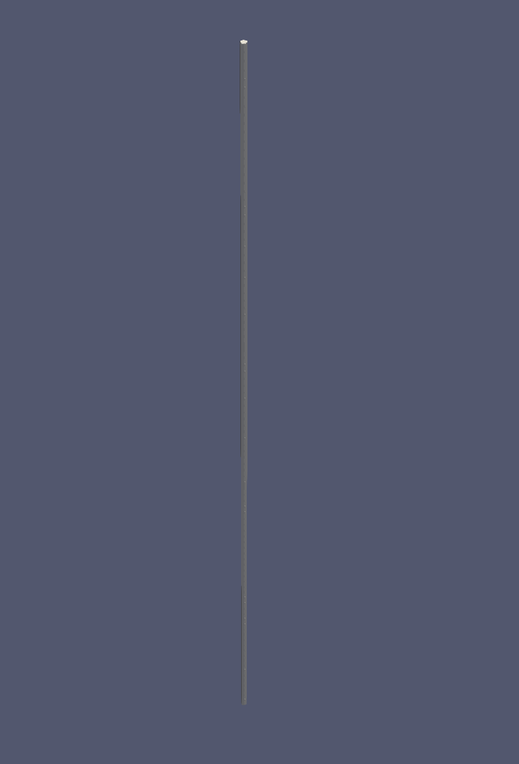

流体网格
浸入表面
固体网格

Slide 16
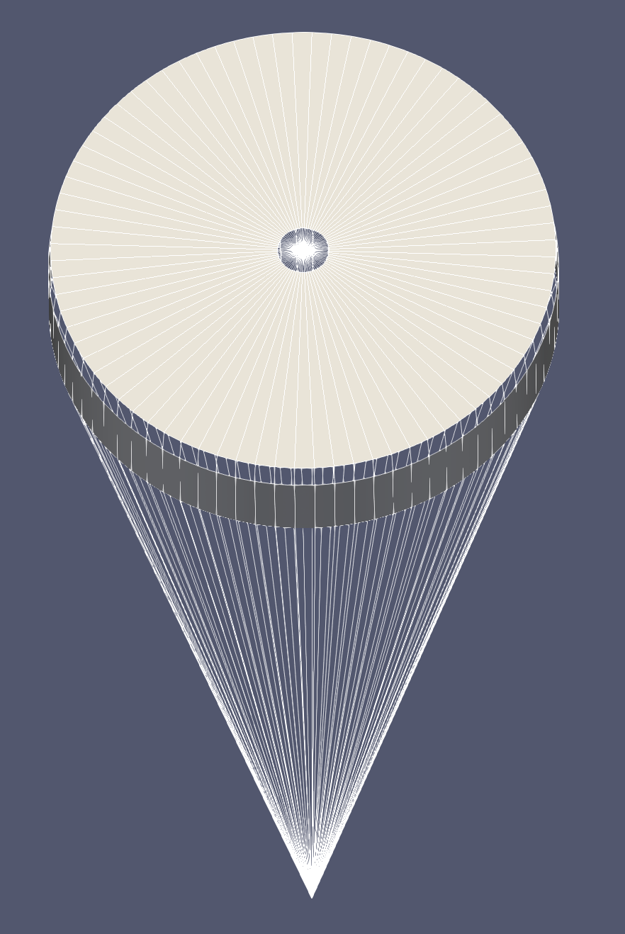
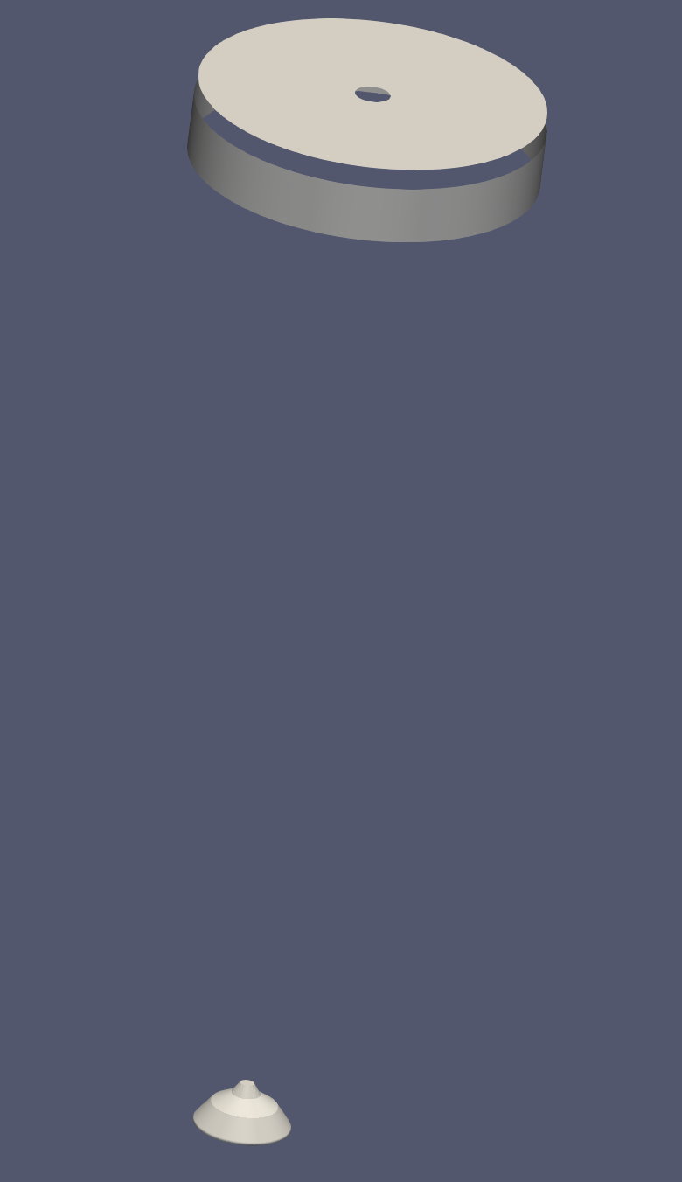
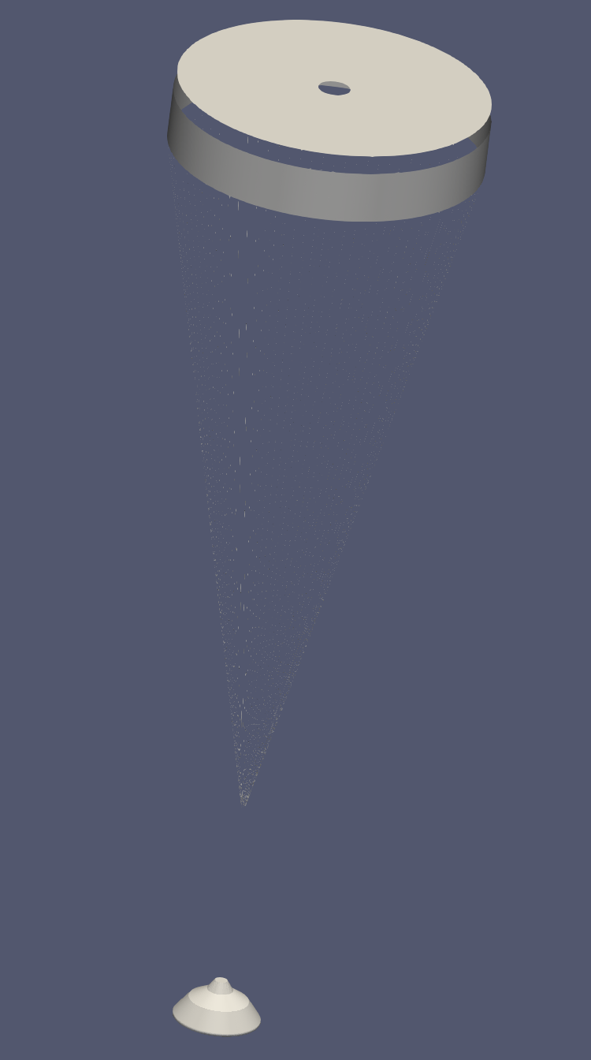
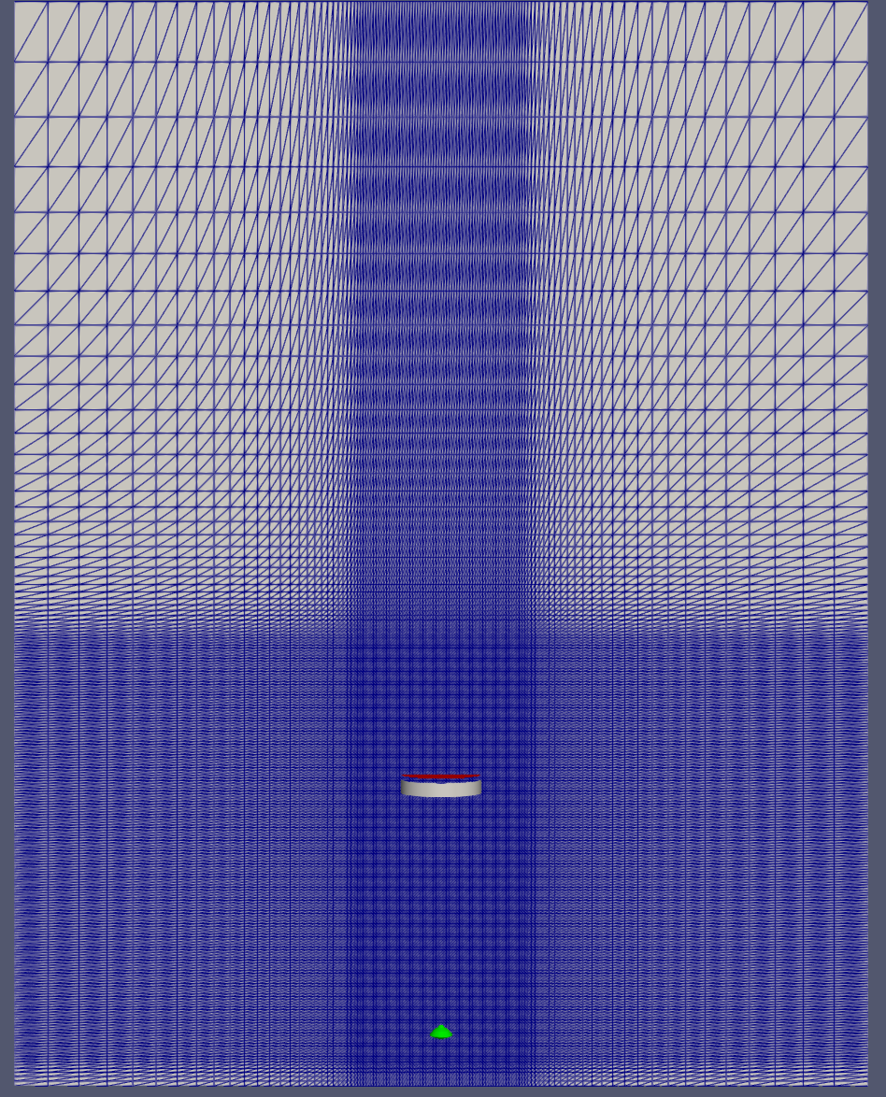
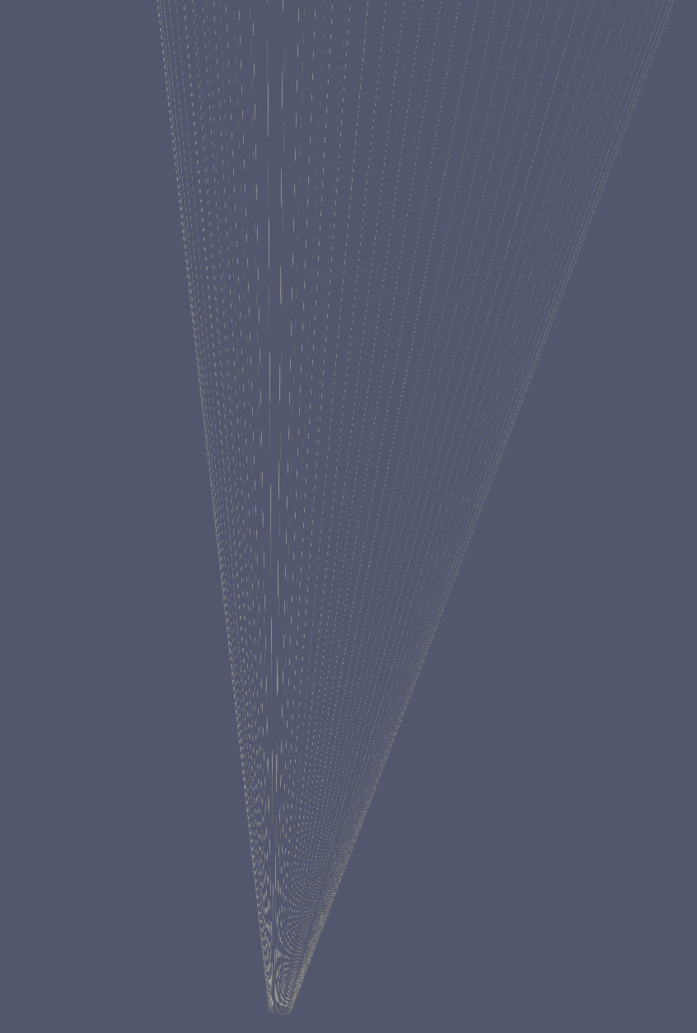
固体网格 浸入表面 浸入表面(包括悬挂线) 流体网格

Slide 17
